Slide 1
From atoms to stars I: nucleosynthesis
Richard J. Stancliffe
(University of Hull, UK)

Slide 2
Overview
Where does everything come from?
How do we make all the elements found in the Universe?
The role that stars play in producing elements

Slide 3
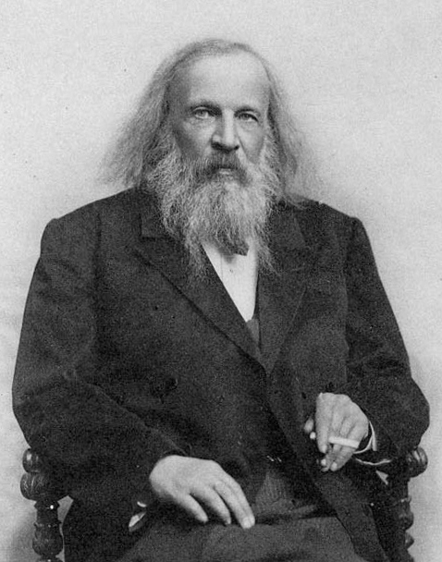
What is an element?
An element is a nucleus with a given number of protons in it
An atom of that element has the same number of electrons as protons
We identify each element with its own symbol
This determines its chemical properties
This is where the Periodic Table of the Elements comes from
Dimitri Mendeleev (Wikipedia)

Slide 4
Notes:
Caveat – at the present day!

Slide 5
What is an isotope?
Nuclei with the same number of protons can have different numbers of neutrons
We call these isotopes of the same element
We can make a table of isotopes
We call this the chart of the nuclides

Slide 6
⁴Li
⁵Li
⁶Li
⁷Li
³He
⁴He
⁵He
⁶He
Number of protons
¹H
²H
³H
⁴H
⁵H
n
Number of neutrons

Slide 7


Slide 9
Data: Asplund et al. (2009)

Slide 10
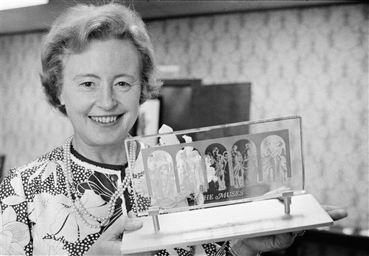
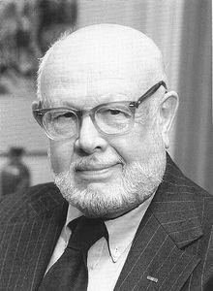
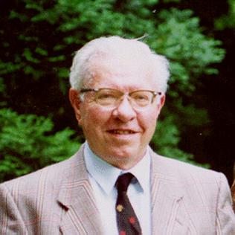
B²FH -- 1957
The cornerstone of nucleosynthesis
Looked at the solar abundance pattern
Thought about nuclear structure
Deduced the processes that must happen
Margaret Burbidge, Geoffrey Burbidge,
Willy Fowler, Fred Hoyle

Slide 11
Mass defect
Stars powered by nuclear fusion
First step: convert 4 protons into 1 helium-4 nucleus
Atomic mass of hydrogen is 1.00794
Atomic mass of helium is 4.002602 < 4x1.00794
The difference is the energy released
Notes:
E = delta m c^2 = 4.03176 – 4.002602 c^2 = 0.029158 c^2
= 27 MeV

Slide 12
Hydrogen fusion I
Proton-proton chains
PPI:
PPII:
PPIII:

Slide 13
PP CHAINS
Number of protons
Number of neutrons

Slide 14
Hydrogen fusion II: CNO
¹³C
¹⁴N
¹⁷O
¹⁸F
Reactions:
(p,γ)
(β⁺)
(p,α)
¹³N
¹⁵O
¹⁷F
¹²C
¹⁵N
¹⁶O
¹⁸O

Slide 16
Other proton fusion reactions
Carbon, nitrogen and oxygen aren’t the only things to be involved in cycles
Ne-Na and Mg-Al also have their own cycles
Beyond this, nuclei are too highly charged for proton capture reactions to occur

Slide 19
Helium burning
Needs T > 10⁸ K
3 ⁴He ¹²C
3-body reaction, very temperature sensitive
Once carbon is made we can also make oxygen
¹²C + 4He ¹⁶O

Slide 20
Notes:
More than just alpha captures!

Slide 21
Carbon burning
Helium burning leaves us with ¹²C and ¹⁶O
At T > 5 x 10⁸ K, carbon fusion can happen
3 possible pathways
¹²C + ¹²C ²⁴Mg + γ
¹²C + ¹²C ²³Na + p
¹²C + ¹²C ²⁰Ne + α
Leaves us with a composition of oxygen, neon and magnesium.
Notes:
Last two most likely. Messy side reactions.

Slide 22
Further burning
Next comes neon burning 1.5x10⁹ K
Produces mostly oxygen and magnesium
Then oxygen burning 2x10⁹ K
Results primarily in silicon and phosphorous
Final phase is silicon burning 3x10⁹ K
Gives us ⁵⁶Fe
Notes:
Oxygen is a stable nucleus – doesn’t want to react.

Slide 23
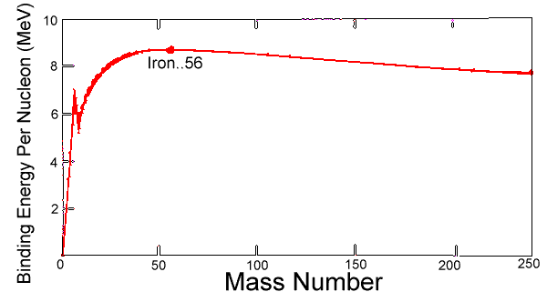
No more energy from fusion!
What happens after we get iron?
Iron is the most tightly bound nucleus
We can’t get energy out of fusion anymore
Bad news for the star…

Slide 24
Nuclear Reactions
Temperature increases
hydrogen helium
helium carbon, oxygen
carbon magnesium, neon
oxygen silicon
silicon iron

Slide 25
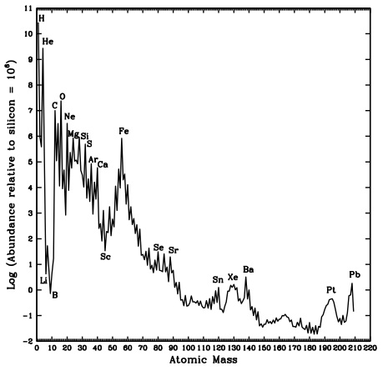
Reactions beyond iron
How do we get elements beyond iron?
Can’t easily add charged particles
But neutrons are a different matter…

Slide 26
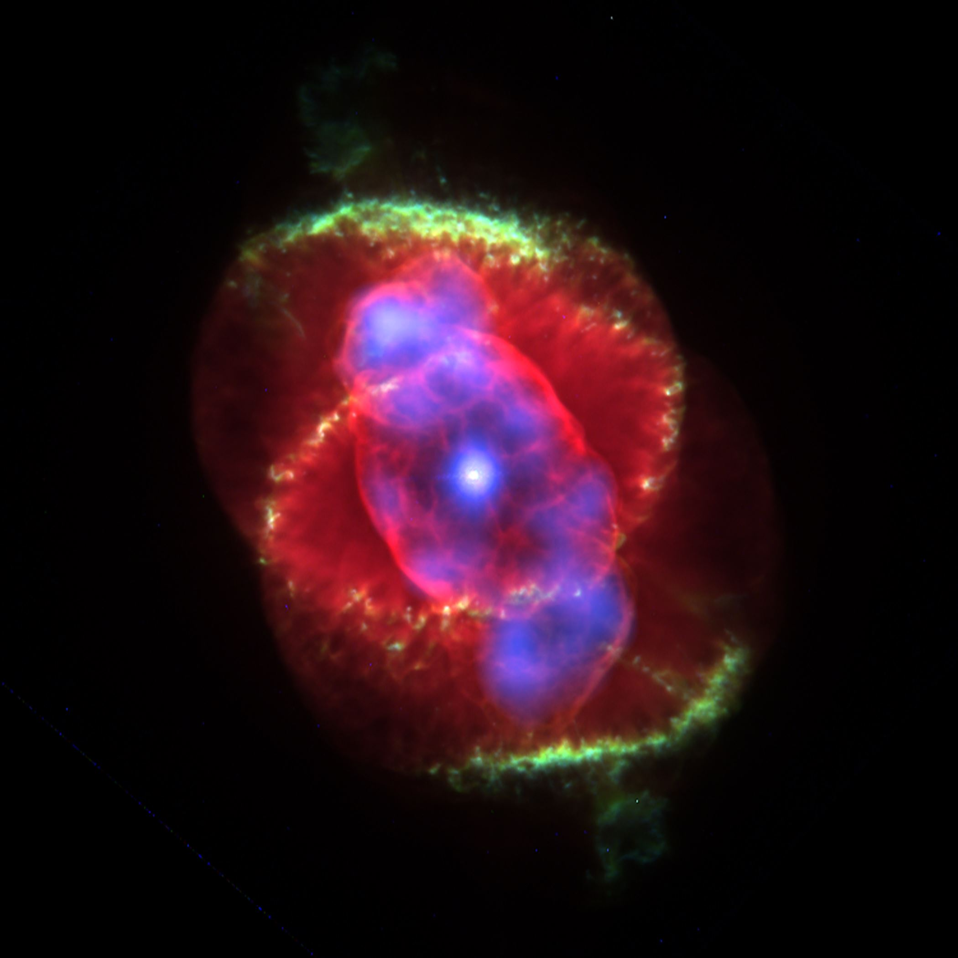
Slow neutron capture (s-process)
Hard to make heavy elements with charged particle fusion reactions
Low neutron density
Happens in low mass stars
Long timescales
Produces: S, Y, Zr, Ba, La, Ce, Pb
Same stars make C, N too
NGC 6543, Cat’s Eye Nebula

Slide 27
N = 82

Slide 28
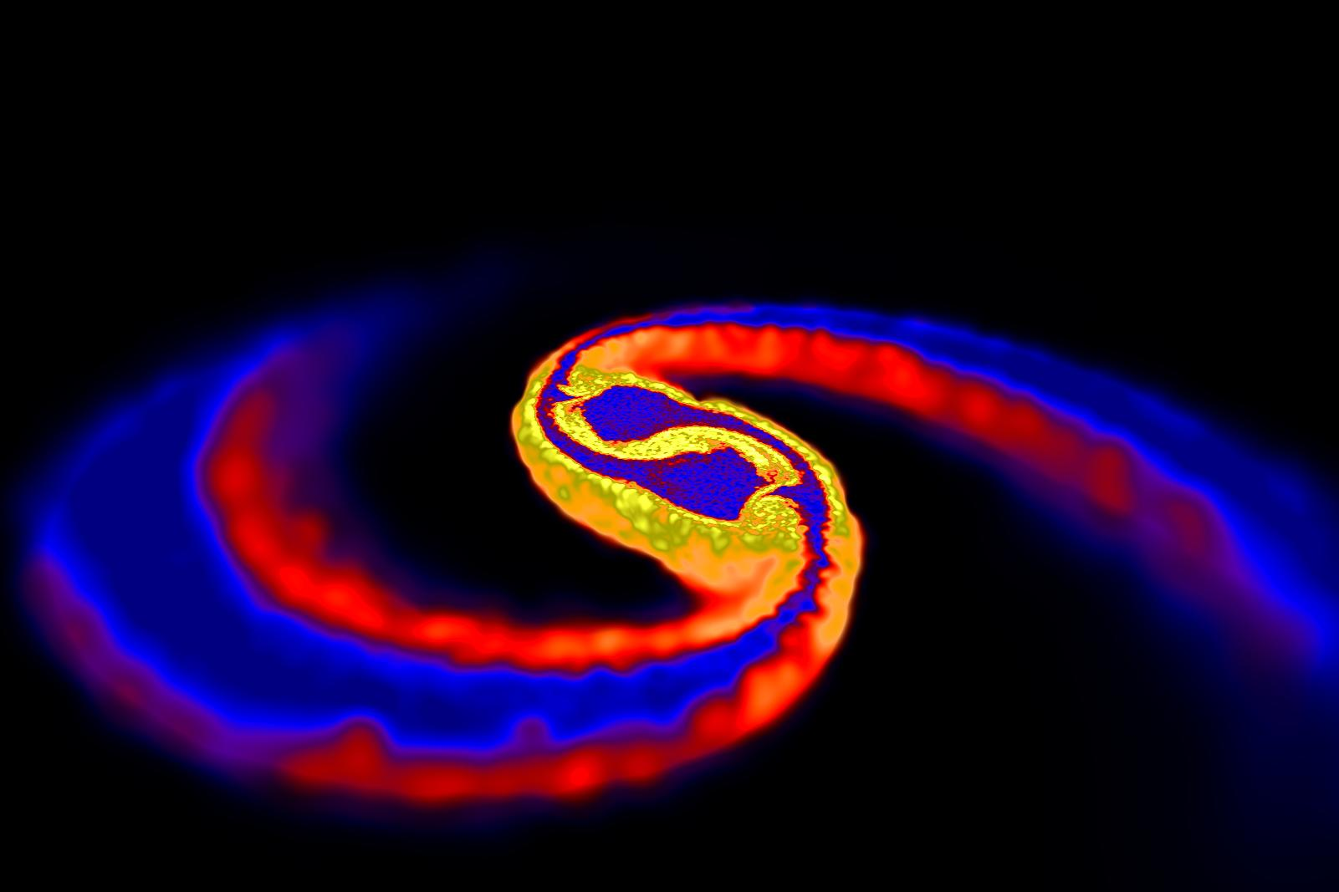
Rapid neutron capture (r-process)
Violent conditions can produce high neutron densities
Different form of neutron captures
Found in merging neutron star systems
GW170817
Could also be CCSNe
Produces: elements around A = 82, 130 and 196
Rosswog/Price
Notes:
Varying timescales!
Se, Br, Kr, Te, I, Xe, Os, Ir, Pt.

Slide 29
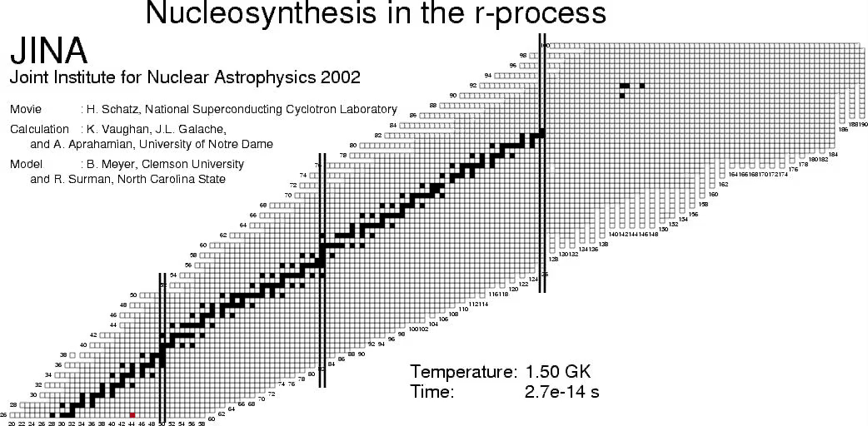

Slide 30
Something in between?
The s-process stays near the stable nuclei
The r-process goes very far away from stability
Is there a way to make those isotopes in between?
YES! We call it the intermediate (i) process

Slide 31
s process, n = 10⁷ cm⁻³
Hampel (2015)

Slide 32
n = 10¹² cm⁻³
high
mass fraction
Z
low
N

Slide 33
n = 10¹⁵ cm⁻³
Hampel et al. (2016)

Slide 34
Certain old stars have i-process patterns
Hampel et al., (2016)

Slide 35
Summary
Nucleosynthesis is like lego: add small things together to make bigger things
Fusion reactions:
We need hotter temperatures to fuse heavier nuclei
Heavy elements by neutron captures
Slow capture in low mass stars
Rapid capture in violent conditions

